Slide 1
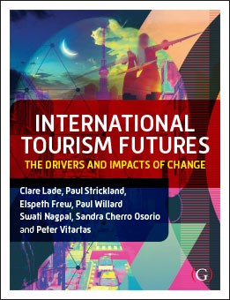

Chapter 4: Hospitality of the Future

Slide 2
Chapter Outline
Introduction
The changing hospitality sector and technology advancement
  Space hotels
  Underwater accommodation
  Cruise ship industry (prior to COVID-19)
  Robots in the hospitality sector
Challenges of traditional employment roles versus future expectations
Advantages and disadvantages of artificial intelligence
Summary
Case study and additional resources

Slide 3
Introduction
Hospitality will always exist as people need to:
  Eat
  Sleep
  Drink water
People crave different experiences hence;
  Different types of restaurants
  Different levels of accommodation
  Variety of beverages (both alcoholic and non-alcoholic)
Notes:
Firstly, the traditional function of the hospitality sector will always exist. This is due to the natural need for food, water and sleep. The physiological requirement for sustenance is essential for all creatures to survive. As Calpaldi stated ‘eating is arguably the most fundamental of human activities’ (1996:1). Additionally, sustenance does not necessarily need consumption in a restaurant or other hospitality venues, however, humans crave different foods, tastes and experiences. A restaurant for example, can satisfy these desires. Secondly, water is another element for the function of life and survival (Saltmarch, 2001).

Slide 4
Introduction
Hospitality is loosely based on Maslow’s Hierarchy of Needs (1943):
  psychological, (food and beverages)
  safety, (accommodation and transport)
  belonging, (meeting family and friends in social settings i.e bars and restaurants
  esteem, (being able to afford high service levels), and
  self-actualisation concerns (holidaying/relaxing in preferred setting – cruise ship)
Notes:
Chung-Herrera (2007) suggests that successful businesses in hospitality attempt to satisfy all these levels from a customers’ viewpoint especially psychological and safety needs. Guests are more likely to stay longer and become repeat customers if the overall experience surpasses their expectations.

Slide 5
Future of Space Travel for Tourists
Space travel is not current a commercial reality but will be in the future.
First space capsules will be small, cramped and require extensive guest training (Strickland, 2012)
Limiting factors include cost restraints and technological challenges
  overcoming gravity,
  food production and
  water collection

Slide 6
Future of Space Travel for Tourists
Traditionally a good hospitality worker has four main attributes:
  good work ethic,
  being punctual,
  being responsible, and
  always accountable (Alonso and O'Neill, 2011)
Skills of a space hotel worker may be:
  how to use equipment to heat food,
  challenges of consuming a hot beverage,
  ability to use a toilet,
  application of telecommunications,
  administering first aid and
  perhaps pilot a space shuttle (Strickland, 2017)

Slide 7
Underwater Hotels
Underwater hotels have great potential as 70% of the earth is underwater.
Currently, most underwater hotels mimic a 5 star hotel:
  Conrad Maldives’ ‘The Muraka’ on Rangali Island is an example of an underwater hotel
  Review website for discussion: www.conradmaldives.com
Notes:
Underwater hotels are found in Dubai, Florida, Sweden, Maldives, Zanzibar, St Lucia and Fiji

Slide 8
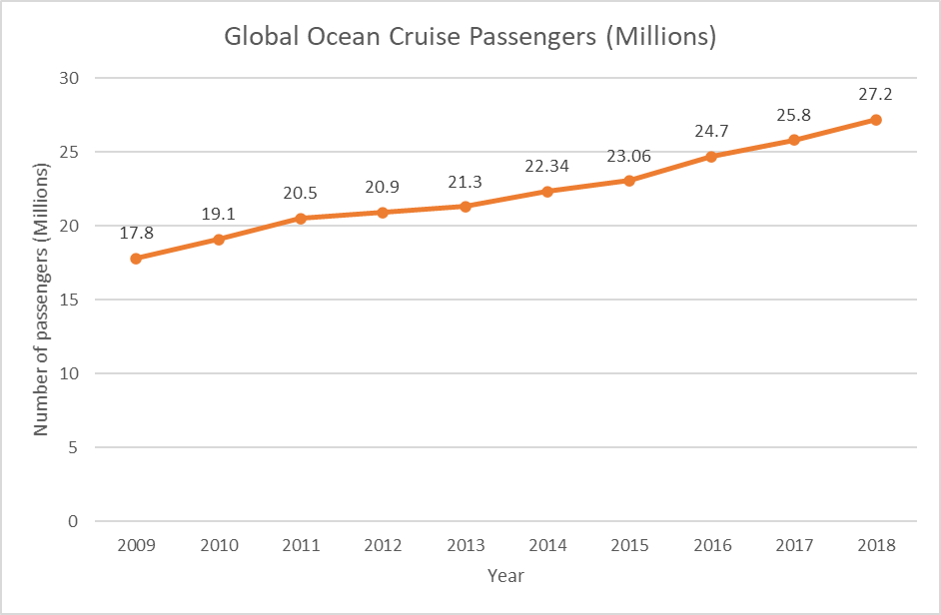
Cruise Ships industry (prior to COVID-19)
Source: The Florida-Caribbean Cruise Association, 2018

Slide 9
Cruise Ships industry (during COVID-19)
2020
Source: The Florida-Caribbean Cruise Association, 2018
Notes:
Furthermore, GOC states the most popular sailing routes are throughout the Caribbean (35%), followed by the Mediterranean (15%), other ports of Europe (15%), China (12%), Australia/New Zealand (7%), Asia (7%), Alaska (5%) and South America (4%) (The Florida-Caribbean Cruise Association, 2018: 1). These statistics make it apparent which markets have the potential for increasing capacity or where the market demands. For example, Africa and Antarctica are not a destination for GOC but this may change in the future to increase capacity and destination appeal.
2020 – no cruise ship activity

Slide 10
Cruise Ships industry (after COVID-19)
Cruise Ships were deemed COVID-19 hot spots due to the closeness of passengers and rooms. The pandemic exposed many issues that will need to be addressed in the future including:
  reside in tax havens such as Barbados and no-one is accountable,
  mass tourism at ports,
  environmental concerns,
  poor wages and
  cramped working conditions of cruise ship staff
Notes:
Limited cruise ship activity. Many ships had been scraped.

Slide 11
Cruise Ships industry (after COVID-19)
Cruise Ships were deemed COVID-19 hot spots due to the closeness of passengers and rooms. The pandemic exposed many issues that will need to be addressed in the future including:
  reside in tax havens such as Barbados and no-one is accountable,
  mass tourism at ports,
  environmental concerns,
  poor wages and
  cramped working conditions of cruise ship staff
Notes:
America and Europe are most likely the first to return to the seas as people have had the virus or been vaccinated.

Slide 12
Customer Service of the Future
Desirable attributes of a hospitality worker:
  empathy,
  warmth,
  competence, pleasant personality,
  honesty,
  efficiency,
  punctuality,
  a willingness to learn,
  undertake given tasks and
  an awareness of personal hygiene and grooming (Bufquin, DiPietro, Orlowski and Partlow, 2017)

Slide 13
Customer Service of the Future
Good hospitality workers assist in the profitability of the business. Other positive outcomes are:
  If restaurant staff members are enjoying their workplace, they are more likely to work harder, longer and less likely to resign (AlBattat, Som and Helalat, 2013).
  Financial rewards may flow through such as:
    gratuities,
    tips,
    promotions and increased compensation for workers which can also be a competitive advantage.

Slide 14
Robots in the Hospitality Sector in Asia
Robots are a ‘relatively autonomous physical device capable of motion and forming a service’ (Murphy, Hofacker and Gretzel, 2017: 106)
The most common robots featuring in hospitality today undertake manual tasks such as:
  cleaning,
  delivering room service,
  aiding the elderly or
  a substitute for human companionship
Notes:
In the words of Ivanov, Webster and Berezina ‘robots have arrived and are here to stay’ (2017: 1513).

Slide 15
Robots in the Hospitality Sector in Asia
Robots in the hospitality sector are for service automation. For example in restaurants:
  robotic chefs,
  baristas,
  servers,
  dishwashers,
  automated ordering,
  entertainment and
  payment systems (Ivanov, Webster and Berezina, 2017).

Slide 16
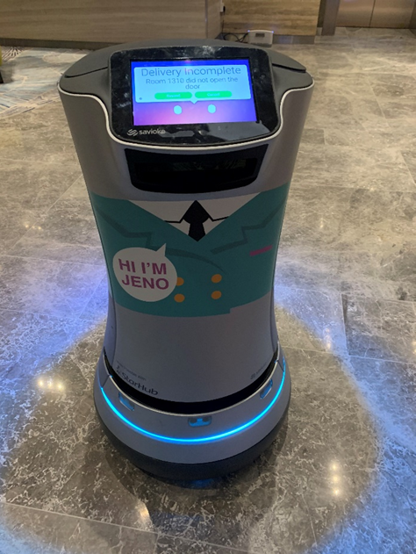
Robots in the Hospitality Sector in Asia
Asian hotels have cases of robots already implemented in front office stations, concierge desks, guest relation areas, housekeeping (vacuuming), porterage and room service for increased efficiency
(Rajesh, 2015)
Notes:
Jeno from Hotel Jen in Singapore delivering room service
(Source: Paul Strickland, 2020)

Slide 17
Robots in the Hospitality Sector in Asia
An article published in 2017 titled ‘Robots in Hospitality: Five Trends on the Horizon’ highlight the following five concepts:
    1. Robots assist humans with mundane tasks
    2. Robots will create more jobs
    3. Hospitality will lead the way for embracing robots
    4. Robots and data collection
    5. Acceptance of robots and removal of anxiety

Slide 18
Advantages of Robots
economic benefit
robots can work 24-hours a day making them more efficient.
perform tasks to set service standards
do not convey a negative attitude, drink alcohol, smoke cigarettes or take illicit drugs
do not complain, get ill, go on strikes, spread rumours
speak different languages (Wilcock, Laxström, Leinonen, Smit, Kurimo and Jokinen 2017)
Notes:
Robots require no sick or family days or bonuses and no need for training or hiring or being let go, be programmed for a variety of different duties, have their capabilities expanded with hardware and software updates and improve quality of the customer experience in a timely manner, discriminate, quit their job without notice, show negative emotions, shirk from work but do undertake routine and undesirable tasks

Slide 19
Disadvantages of Robots
mass job loss for hospitality workers (also will create more jobs in hospitality such as in maintenance, software development and hardware requirements for robots)
(Ivanov, 2017)
reduce the ‘human touch’ element of the service industry (Pieska, Luimula, Jauhiainen and Spiz, 2013)
require guidance, structure and lack creativity
Notes:
This means traditional skills will be transferred to other areas that support the robotic industry such as a traditional kitchen hand learning how to maintain an automated commercial dishwasher.

Slide 20
Summary
Space hotels, underwater hotels, and the use of robots to replace hospitality workers will all become a reality on the future.
Trends in the cruise industry are going to be very difficult to predict due to COVID-19. The potential for expansion and growth is immense but it will not return to normal until a vaccination is administered to passengers.
There are both advantages and disadvantages in using robots in the hospitality sector.

Slide 21
Case Study
Case Study: View the clip
https://www.youtube.com/watch?v=6ap5bFYF-yw
Discussion Questions
Robots already feature in restaurants in Southeast Asia. Explain if the replication of this phenomenon is possible within other continents based on technology, price, clientele and acceptance.
In the future, is there the possibility that robots will be able to handle quality control, health and safety standards of restaurants or will this have to remain a human task due to an individual country’s legislation? If a robot were to accidentally give a customer food poisoning, who is responsible? Explain your thoughts.

Slide 22
Additional Resources
Connie the Concierge: https://newsroom.hilton.com/corporate/news/hilton-and-ibm-pilot-connie-the-worlds-first-watsonenabled-hotel-concierge
Five Trends on the Horizon’ highlight the following concepts: https://hospitalitytech.com/robots-hospitality-five-trends-horizon

